Slide 1
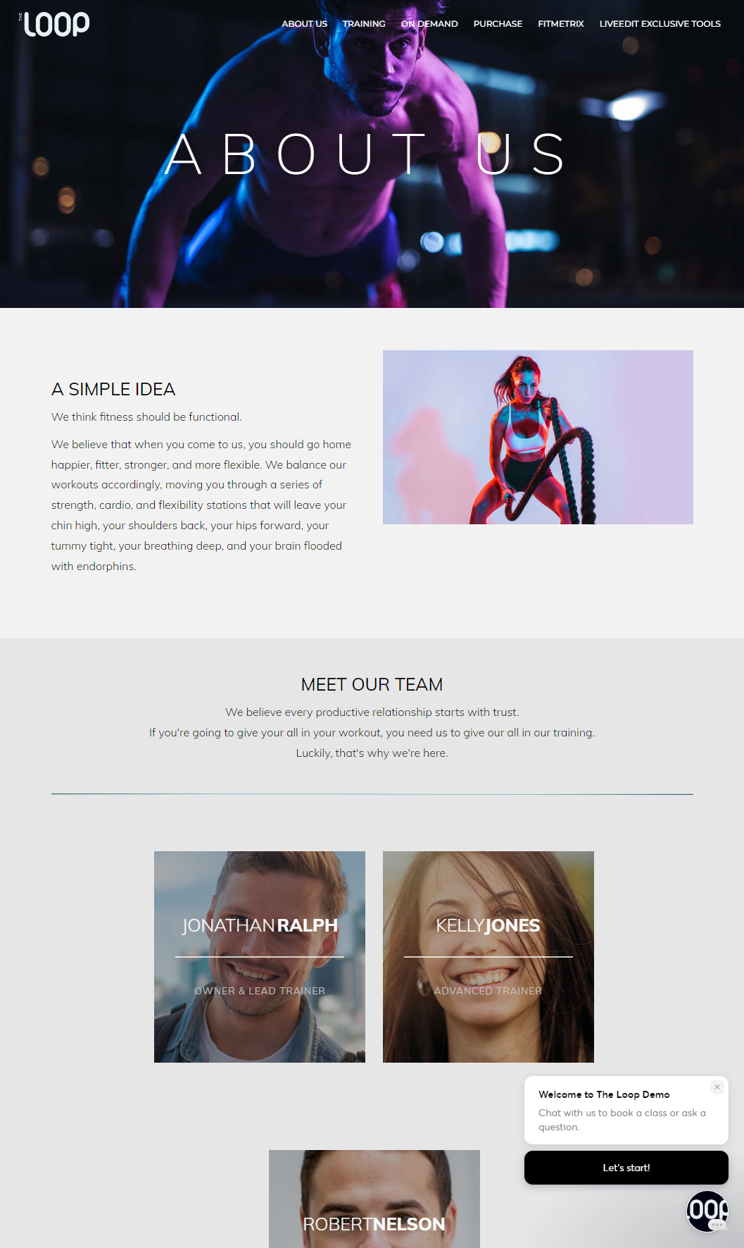
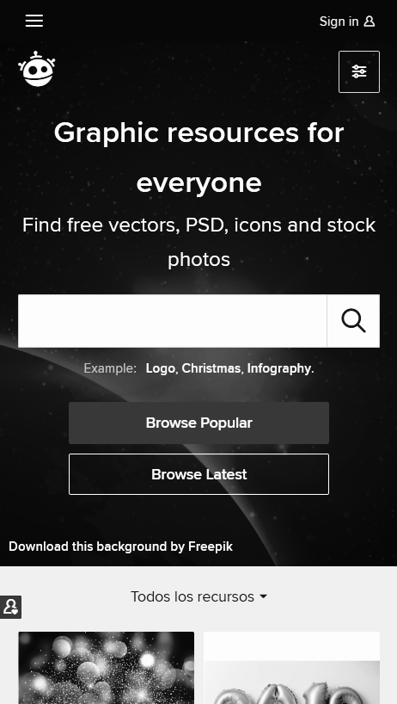
APP DESCRIPTION
The Loop
Fitness website
Accessibility for the user to memberships, schedules & information's
Fitness Products

Slide 2
Testing approach
-Exploratory testing for understanding better the main functionalities and finding early bugs
-Documented exploratory and noted the issues found
-Component testing, System testing
-Ad-hoc for testing the areas where the most bugs were found
-Writing Smoke test and executing it
-Scripted testing for specific areas
-Test Report

Slide 3
Tools used
Mantis - Bug reporting
TestLink - Test Case Management
Snipping Tool - Screenshots Capture
Generatedata – Test information
Xmind Tool – Mind Map

Slide 4
Testing Types
Performed Tests
Applicable Tests
Functional Testing
Scripted Testing
Negative Testing
Compatibility Testing
Exploratory Testing
Ui Testing
Performance Testing
Regression Testing
Security Testing

Slide 5
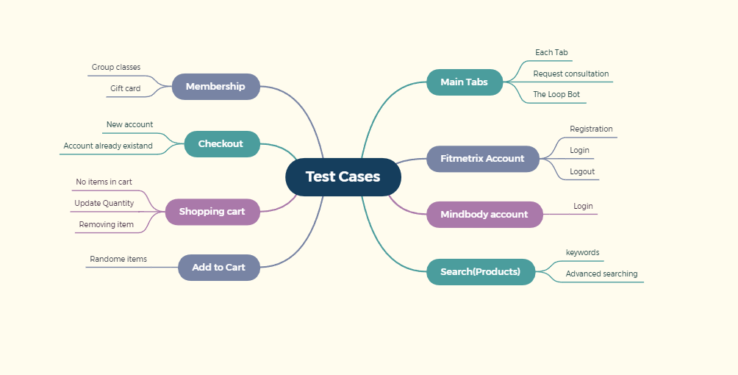
TEST CASES OVERVIEW
22 Test Cases

Slide 6
BUGS OVERVIEW

Slide 7
TEST CASES RESULTS
Functionality | Total | Pass | Failed | Blocked | Not Run | Defects
Main Tabs | 7 | 4 | 3 | 0 | 0 | 0042803 0042599 0042801
Memberships | 2 | 2 | 0 | 0 | 0
Purchase | 4 | 4 | 0 | 0 | 0
Shopping cart | 2 | 2 | 0 | 0 | 0
Checkout | 2 | 2 | 0 | 0 | 0
Mindbody account | 1 | 1 | 0 | 0 | 0
Fitmetrix account | 2 | 2 | 0 | 0 | 0
The loop bot | 1 | 1 | 0 | 0 | 0
Consultations | 1 | 1 | 0 | 0 | 0
Percentage | 100% | 85% | 15% | 0% | 0% | 3

Slide 8
CONCLUSIONS
Data type used during testing: Valid, Invalid, Big Data, Blank
22 Test cases were executed : 19 passed and 3 failed
80% of the bugs were found by performing Exploratory testing and smoke tests
From the 12 of found bugs 10 of them are Major,Critical and 2 of Them Noraml, minor
Fixing at least the Critical and Major severity bugs is highly recommended

Slide 9
LESSONS LEARNED
Exploratory Testing & Ad-hoc Testing is good practice for learning quick the main functionalities
A good balance of Valid and invalid data is important
Lack of Requirement
Planning is the key

Slide 10
THANK YOU!
Feedback? Recommendations?

